Slide 1
Reconstruction
UNIT 1

Slide 2
Types of Gov’t
A unitary system gives all key powers to the national or central government. The central government can still set up other local or state governments.
China is an example of unitary government

Slide 3
Types of Gov’t Cont.
Governments range in size and type. Most larger countries have several levels of government – national, state, and local.
The federal system divides the powers of government between levels of governments.
Each level has sovereignty in some areas.
The U.S. is an example of a federal system.

Slide 4
Types of Gov’t Cont.
A confederacy is a loose union of independent states.
USA started as a confederacy
Southern US states formed a confederacy during Civil War
The Commonwealth of Independent States (CIS), formerly known as the Soviet Union.

Slide 5
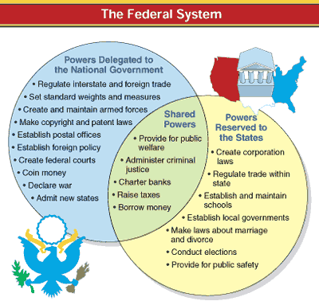
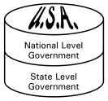
Federalism
System of government in which a written constitution divides the power between a central government and several local governments – divides power between National (Federal), State and Local governments

Slide 6
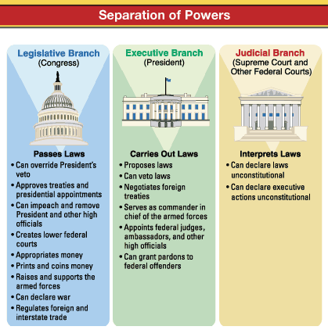
Separation of Powers
Basic principle of American system of government
Executive, Legislative, and Judicial powers are divided among three independent and co-equal branches of government
Enhances concept of limited government by dividing up the power, to prevent concentration of power in one individual

Slide 7
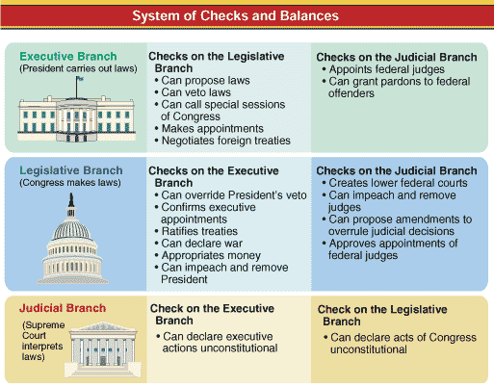
Checks and Balances
Basic principle of the American system of government
System of overlapping powers of the legislative, executive, and judicial branches to permit each branch to check the actions of the others

Slide 8
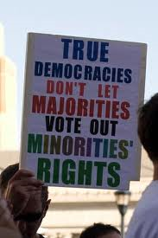
Principles of American Political Culture – Majority Rule / Minority Rights
Although the majority has the right to rule or pass laws, they may not deny the rights of a minority group

Slide 9
Constitutions and Gov’t
A constitution is a plan that provides the rules for government.
Could be written
It has 3 major purposes:
(1.) it sets out ideals that the people bound by the constitution believe in and share;
(2.) it establishes the basic structure of government and defines the government’s powers and duties; and
(3.) it provides the supreme law for the country.

Slide 10
Causes of the Civil War

Slide 11
State’s Rights
Theory that the individual states could override federal laws that they felt were unjust
Started in 1798 in the Kentucky Resolutions by Thomas Jefferson and James Madison

Slide 12
The Nullification Crisis
Constitutional ambiguity, sectional interests, and the states’ rights issue caused political controversies.
The 1828 “Tariff of Abominations” elicited a strong reaction from South Carolina. Southerners argued that the tariff was an unconstitutional effort to enrich the North at southern expense.
John C. Calhoun wrote a defense of the doctrine of nullification claiming states could refuse to enforce laws they deemed unconstitutional.
South Carolina nullified the 1833 tariff and threatened to secede.
Jackson considered South Carolina’s action treason and passed the Force Bill.
Henry Clay engineered a compromise tariff that ended the threat of civil war.

Slide 13
Expansion of slavery
Major issue leading to civil war
Fear of imbalance of power in congress

Slide 14
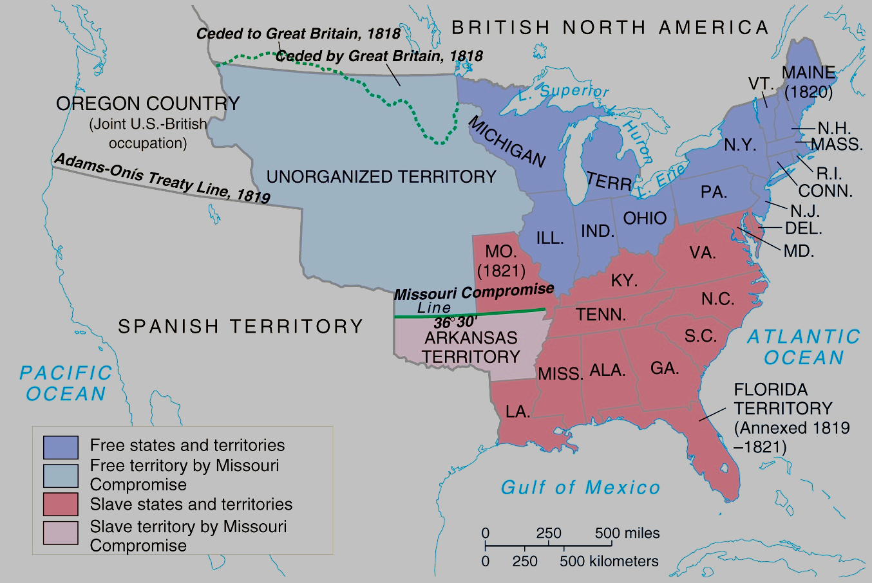
Missouri Comp

Slide 15
Missouri Compromise
Allowed MO to be admitted as a slave state if Maine was admitted as a free state
Maintained balance
Abolished slavery in any territory south of MO

Slide 16
Compromise of 1850
The Compromise of 1850 was actually five separate bills
California came in as a free state.
Other southwest territories were to be settled by popular sovereignty.
A stronger fugitive slave law was enacted.
The slave trade was outlawed in Washington, D.C.
The Texas–New Mexico border dispute was settled.

Slide 17
The Kansas-Nebraska Act
In 1854, Stephen Douglas pushed through a bill to open the Kansas territory.
To win southern support Douglas’s bill declared that the territory would be organized on the principle of popular sovereignty, even though slavery in that territory had been banned under the Missouri Compromise.
The Kansas-Nebraska Act proved to:
destroy the Whig Party
nearly destroy the northern wing of the Democratic Party
negate treaties with Indians removed to Kansas in the 1830s.

Slide 18
The Dred Scott Decision
The Dred Scott decision worsened sectional divisions.
The Supreme Court ruled that Congress could not ban slavery in the territories and that Dred Scott’s long-term residence in free territory did not make him free.
While Southerners applauded the decision, Northerners denounced it.

Slide 19
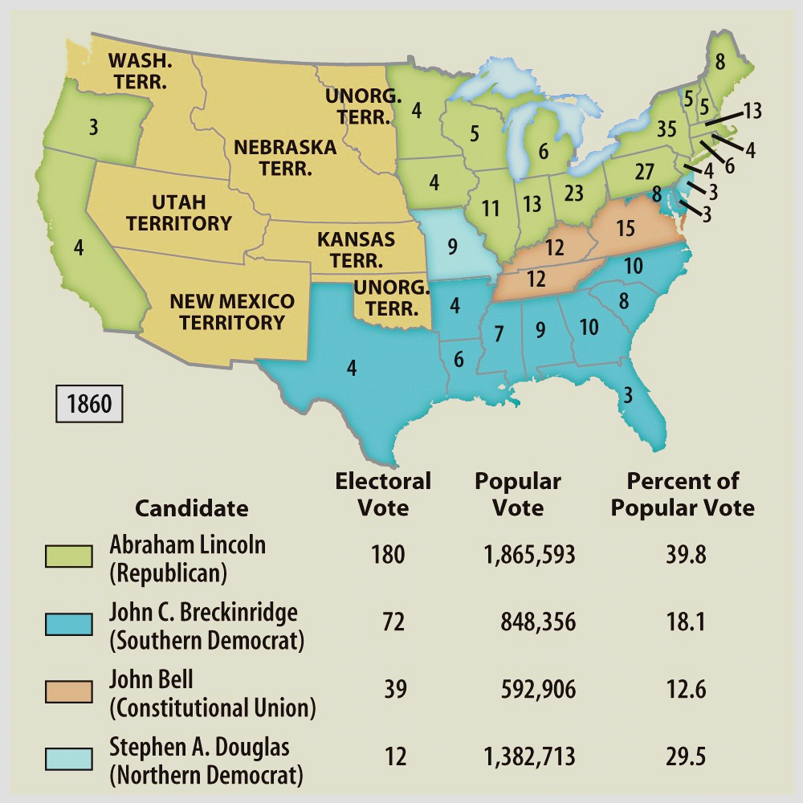
Election of 1860
ELECTION OF 1860
Country is polarized (divided) over the issue of slavery.
Once Lincoln is elected as president, South Carolina will secede from the U.S. along with several other Southern States.
They will form the Confederate States of America---CSA
303 total electoral votes and 152 to win.

Slide 20
THE CIVIL WAR
1861 to 1865
Confederate States of America----CSA
Jefferson Davis---President
Confederate Constitution
Firing on Fort Sumter, April 12, 1861
Lincoln needed border states
South fires first shot
Suspends Constitution
NORTH VS. SOUTH
Advantages
Strategy
Military leaders
Border states were slave states but remained loyal to the North…Lincoln needed them….. Maryland, Delaware, Kentucky and Missouri……..

Slide 21
4. THE WAR YEARS: 1861 TO 1863-----Turning points
Battle Fronts
Western Theater------------------------Eastern theater
Summary: USA is defeating the CSA because of General Grant
1861 to 1863
Summary: CSA is defeating the USA because of General Lee
Lincoln’s “first steps” to abolish slavery
Emancipation Proclamation--Jan. 1863
freed slaves in states still in rebellion
Kept Great Britain out the war
Freed slaves can fight for the Union army
Union troops: “freedom fighters”

Slide 22
The North Wins
April 9, 1865 at Appomattox Court House Lee surrendered to Grant
War over

Slide 23
Key Questions
1. How do we bring the South back into the Union?
4. What branch of government should control the process of Reconstruction?
2. How do we rebuild the South after its destruction during the war?
3. How do we integrate and protect newly- emancipated black freedmen?

Slide 24
Plans of reconstruction
Wartime (Lincoln)
Presidential (Johnson)
Congressional (radical republicans)

Slide 25
President Lincoln’s Plan
10% Plan
Proclamation of Amnesty and Reconstruction (December 8, 1863)
Replace majority rule with “loyal rule” in the South.
He didn’t consult Congress regarding Reconstruction.
Pardon to all but the highest ranking military and civilian Confederate officers.
When 10% of the voting population in the 1860 election had taken an oath of loyalty and established a government, it would be recognized.

Slide 26
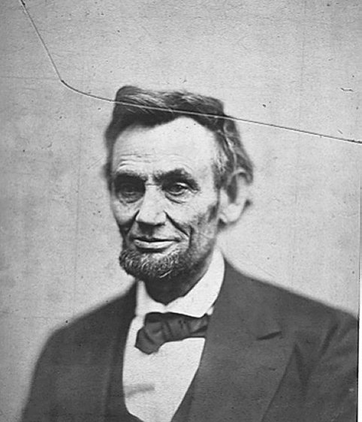
President Lincoln’s Plan
1864 → “Lincoln Governments” formed in LA, TN, AR
“loyal assemblies”
They were weak and dependent on the Northern army for their survival.

Slide 27
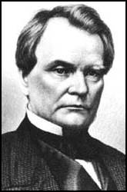
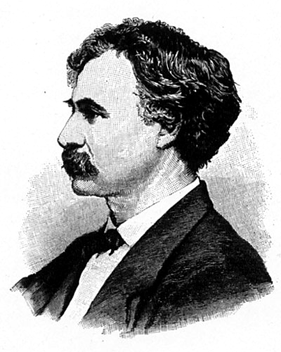
Wade-Davis Bill (1864)
Required 50% of the number of 1860 voters to take an “iron clad” oath of allegiance (swearing they had never voluntarily aided the rebellion ).
Required a state constitutional convention before the election of state officials.
Enacted specific safeguards of freedmen’s liberties.
Senator Benjamin Wade (R-OH)
Congressman Henry W. Davis (R-MD)

Slide 28
Wade-Davis Bill (1864)
“Iron-Clad” Oath.
“State Suicide” Theory [MA Senator Charles Sumner]
“Conquered Provinces” Position [PA Congressman Thaddeus Stevens]
President Lincoln
Wade-Davis Bill
Pocket Veto

Slide 29
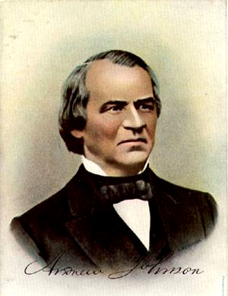
President Andrew Johnson
Jacksonian Democrat.
Anti-Aristocrat.
White Supremacist.
Agreed with Lincoln that states had never legally left the Union.

Slide 30
President Johnson’s Plan (10%+)
Offered amnesty upon simple oath to all except Confederate civil and military officers and those with property over $20,000 (they could apply directly to Johnson)
In new constitutions, they must accept minimum conditions repudiating slavery, secession and state debts.
Named provisional governors in Confederate states and called them to oversee elections for constitutional conventions.
1. Disenfranchised certain leading Confederates.
EFFECTS?
2. Pardoned planter aristocrats brought them back to political power to control state organizations.
3. Republicans were outraged that planter elite were back in power in the South!

Slide 31
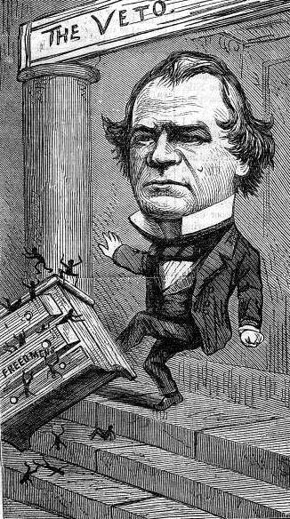
Congress Breaks with the President
Congress bars Southern Congressional delegates.
Joint Committee on Reconstruction created.
February, 1866 → President vetoed the Freedmen’s Bureau bill.
March, 1866 → Johnson vetoed the 1866 Civil Rights Act.
Congress passed both bills over Johnson’s vetoes → 1st in U. S. history!!

Slide 32
Radical Plan for Readmission
Civil authorities in the territories were subject to military supervision.
Required new state constitutions, including black suffrage and ratification of the 13th and 14th Amendments.
In March, 1867, Congress passed an act that authorized the military to enroll eligible black voters and begin the process of constitution making.

Slide 33
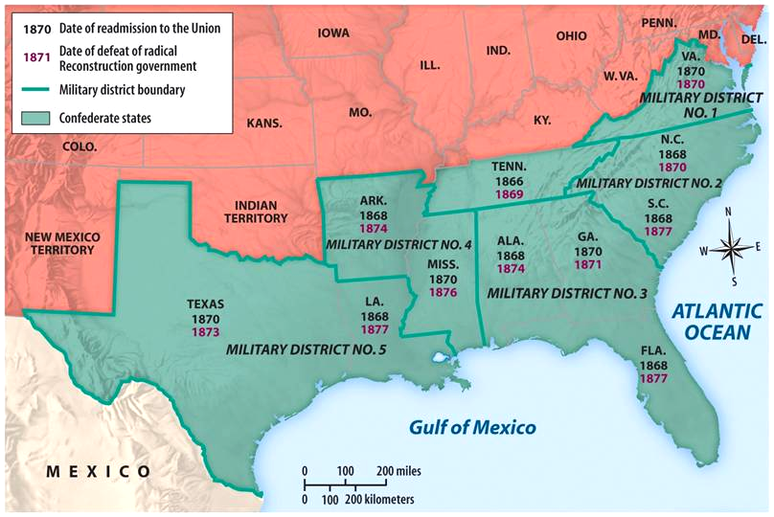
Reconstruction Acts of 1867
Military Reconstruction Act
Restart Reconstruction in the 10 Southern states that refused to ratify the 14th Amendment.
Divide the 10 “unreconstructed states” into 5 military districts.

Slide 34
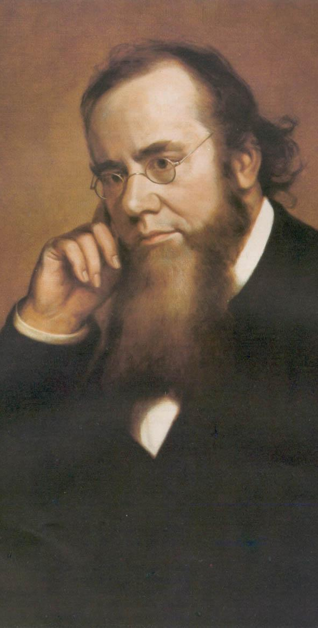
Reconstruction Acts of 1867
Command of the Army Act
The President must issue all Reconstruction orders through the commander of the military.
Tenure of Office Act
The President could not remove any officials [esp. Cabinet members] without the Senate’s consent, if the position originally required Senate approval.
Designed to protect radical members of Lincoln’s government.
A question of the constitutionality of this law.
Edwin Stanton

