Slide 1
Unit 4
American Imperialism

Slide 2
Video 1
Video 2
Video 3

Slide 3
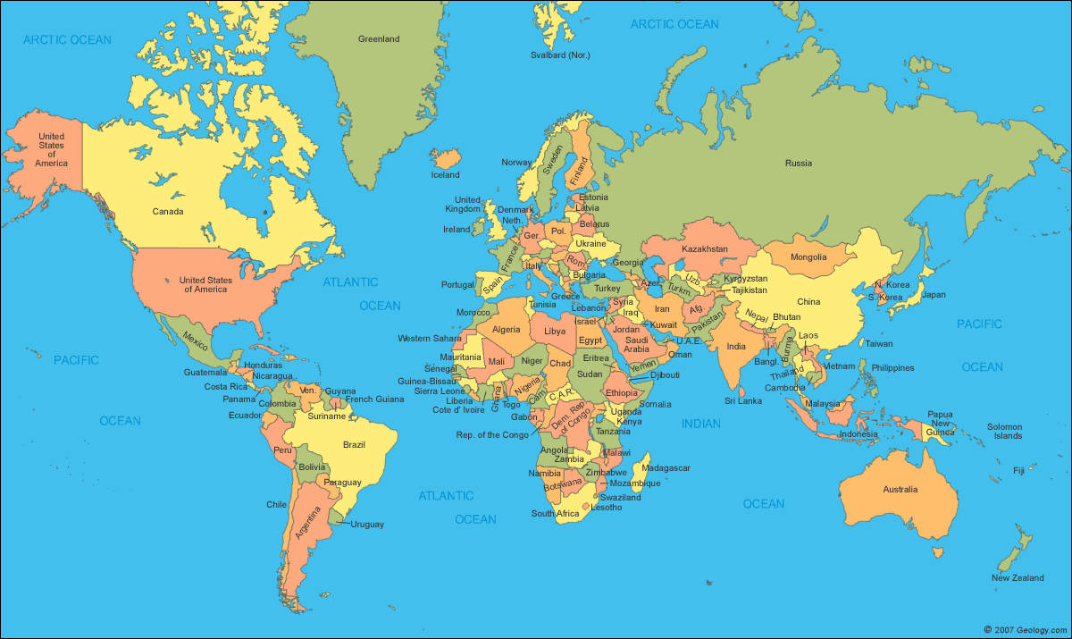

Slide 4
Foreign Policy
foreign policy
a government's strategy in dealing with other nations
State Department
The portion of the Executive Branch in the U.S. that helps the president handle foreign policy issues
Secretary of State
The appointed head of the State Department.
They are in charge of Dealing with other nations.

Slide 5
Foreign Policy
Isolationism
Avoiding foreign wars
stance of the U.S. from 1812-1898.
Imperialism
attempt to gain territory throughout the world by dominating weaker nations
stance adopted by the U.S. in the late 1890s

Slide 6
Latin America

Slide 7
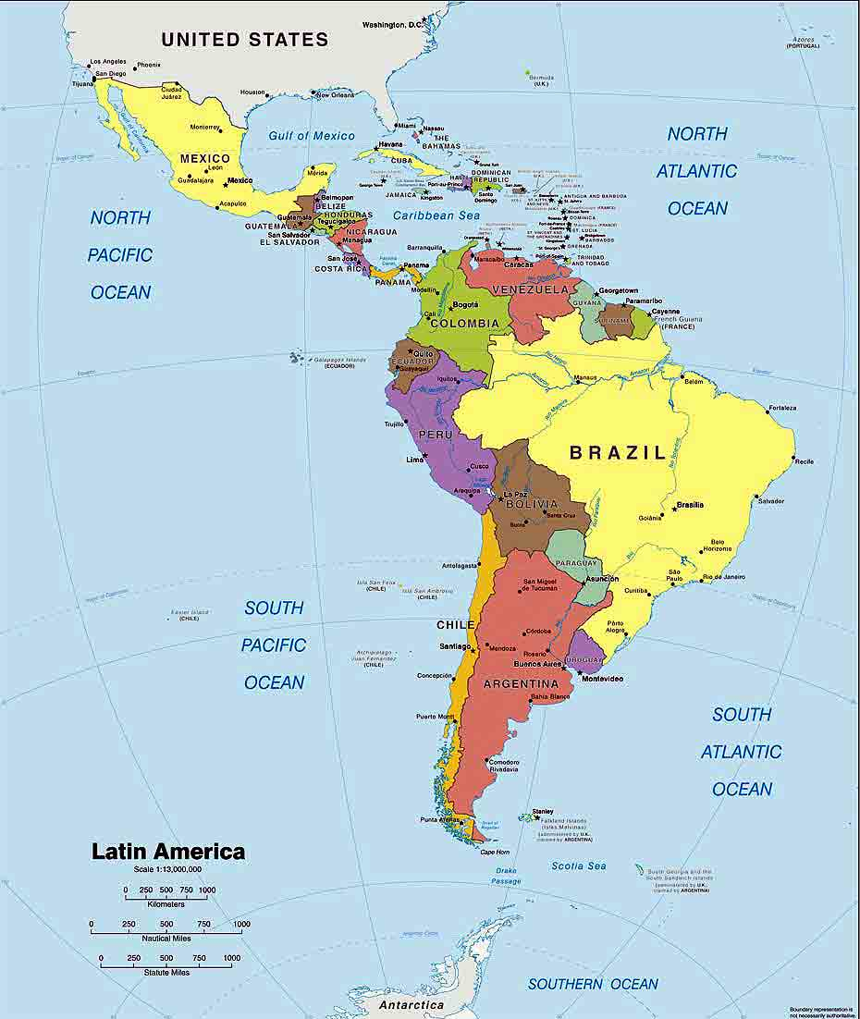

Slide 8
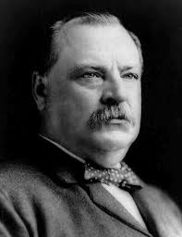
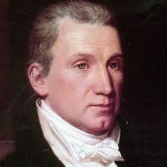
Latin America cont.
Monroe Doctrine
The U.S. foreign policy statement by James Monroe
asserted that the U.S. would control the Americas and intervene if any European Powers interfered.
The idea was to keep European Powers out of “our side” of the world
Venezuelan Border Dispute
U.S. action under the Monroe doctrine
Grover Cleveland’s Secretary of State, Richard Olney, mediated a dispute from a European Nation and a South American Country.

Slide 9
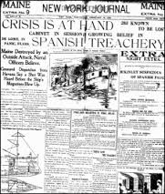
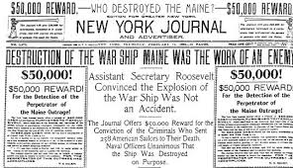
Latin America cont.
The Maine
American battleship that was "mysteriously" blown up while at bay in Cuba.
It was a major cause of the Spanish American War
Yellow Journalism
term for the practice of publishers like Joseph Pulitzer and William Randolph Hearst
They included anti-Spanish propaganda in their newspapers before the Spanish American War in order to stir up support for a war with Spain.

Slide 10
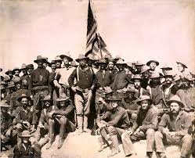
Latin America cont.
Spanish American War
A 10 week war between the U.S. and Spain
fought in the Philippines and Cuba.
Decisive battle in the Philippines was manilla Bay
Decisive battle in Cuba was San Juan Hill
The U.S. won and gained Cuba, Puerto Rico, Guam, and the Philippines
Rough Riders
volunteer soldiers led by Theodore Roosevelt during the Spanish American War

Slide 11
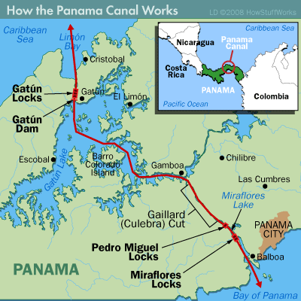
Latin America cont.
Hay-Pauncefote Treaty
Great Britain ceded its interest in building a canal across the Central American isthmus
in return for a US promise to leave such a canal open to ships of all nations.
Panama Canal
The United States started in 1904, and took a decade to complete one of the largest and most difficult engineering projects ever undertaken.
It greatly reduced the time for ships to travel between the Atlantic and Pacific Oceans

Slide 12
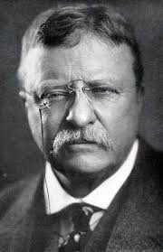
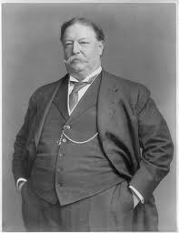
Latin America cont.
dollar diplomacy
The foreign policy stance of President William Howard Taft that focused on using American Banks to give loans to foreign countries in order to maintain trade relations.
Roosevelt Corollary
A 1904 extension of the Monroe Doctrine, stating that the United States would act as debt police for European powers in order to keep peace in Latin America.
U.S. Marines were the actual debt police.
A form of "Big Stick Diplomacy"

Slide 13
Asia and the Pacific

Slide 14
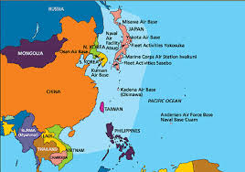

Slide 15
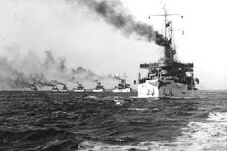
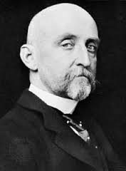
Pacific cont.
Alfred Thayer Mahan
Author of the Book "The Influence of Sea Power Upon History."
He argued that countries with strong naval forces dominated the world.
He inspired the U.S. to build a stronger Navy
The Great White Fleet
sixteen battleships sent by Teddy Roosevelt to sail around the world from 1907-1909 to demonstrate American Military power.
They were painted white.

Slide 16
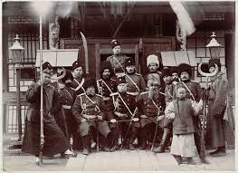
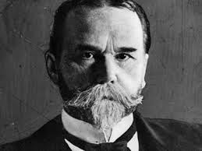
Asia/Pacific cont.
Open Door note
authored by Secretary of State, John Hay in 1899
said all nations should have equal commercial and industrial trade rights in China
Boxer Rebellion
officially supported peasant uprising of 1900
attempted to drive all foreigners from China.
“Boxers” was a name that foreigners gave to a Chinese secret society known as the Yihequan (“Righteous and Harmonious Fists”)
Root-Takahira agreement
1908 - Japan / U.S. agreement in which both nations agreed to respect each other's territories in the Pacific and to uphold the Open Door policy in China.

Slide 17
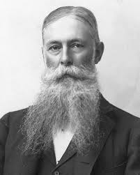
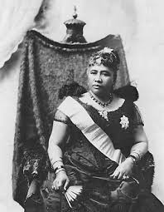
Asia/Pacific cont.
Hawaiian Revolt
American sugar growers revolted against the native Hawaiian monarchy in 1887.
The revolt received assistance from the US Marines and the new government was temporarily recognized by the U.S.
Queen Liliuokalani
Hawaiian Ruler who came to power in 1891.
She removed the 1887 constitution and gave herself royal autocratic powers.
She was eventually overthrown in 1893 by the U.S.

